Slide 1
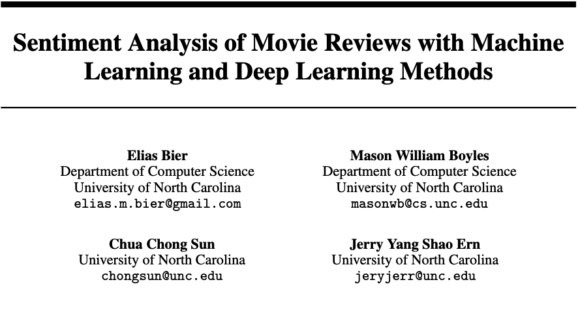

Slide 2
Sentiment Analysis of Movie Reviews
Aim: Classify reviews as positive or negative to extract audience insight.
Why it matters: Helps filmmakers understand viewer preferences and trends.
Research Objective:
  Compare traditional ML models with a modern transformer-based Deep Learning model.
  Evaluate performance under identical preprocessing and training conditions.
Approaches Studied:
  ML: Random Forest, Multinomial Naïve Bayes, Logistic Regression
  DL: Fine-tuned DistillBERT
Notes:
This project focuses on sentiment analysis of movie reviews, specifically classifying each review as positive or negative.
The motivation is that understanding audience sentiment is valuable for filmmakers and studios, since it helps identify trends and viewer preferences.
Our goal was to compare traditional machine learning approaches against a modern deep learning method, DistillBERT.
We implemented three ML models—Random Forest, Naïve Bayes, and Logistic Regression—as well as a fine-tuned DistillBERT transformer.
The idea was to evaluate all models fairly under the same dataset and preprocessing pipeline.

Slide 3
Methods
Data Preprocessing
ML: Cleaning, lowercasing, tokenization, stopword removal, lemmatization
DL: Minimal cleaning; DistillBERT tokenizer handles structure/context
Class imbalance corrected via random oversampling
Feature Extraction
ML: CountVectorizer + TF-IDF (1–3 grams)
DL: DistillBERT contextual embeddings (768-dim)
Models
ML: Train classifiers on vectorized text features
DL: Fine-tune DistillBERT encoder + classification head using AdamW
Notes:
As far as data preprocessing, for ML, we applied heavy preprocessing—cleaning, lowercasing, stopword removal, and lemmatization—to get the text into a standardized form.
For the transformer model, BERT already handles structure and punctuation, so we only applied minimal cleaning and used the DistillBERT tokenizer.
And then there was a class imbalance which we corrected using random oversampling
For feature extraction:
For ML models, we used both CountVectorizer and TF-IDF to convert text to numerical features.
For deep learning, DistillBERT generates contextual embeddings. We then fine-tuned the model with a small classification head using AdamW.

Slide 4
Results
Binary Classification Performance
Logistic Regression (TF-IDF): 90.6% accuracy
DistillBERT (fine-tuned): 93.0% accuracy (best overall)
Key Insights
TF-IDF outperforms simple Bag-of-Words for ML models
DistillBERT captures semantic meaning → stronger generalization
DL offers better performance with moderate computational cost
Oversampling improves fairness and reduces model bias
Notes:
For binary classification, Logistic Regression reached about 90% accuracy, which aligns with common ML baselines for this task.
DistillBERT outperformed all ML models, reaching 93% accuracy, showing the strength of contextual embeddings.
One of the main observations was that TF-IDF is consistently stronger than simple Bag-of-Words, because it focuses on meaningful words rather than frequent but uninformative ones.
The transformer model performs best overall because it captures context and semantics that ML models can’t.
Finally, using oversampling helped reduce bias from class imbalance and improved model fairness across both approaches.

